Slide 1

Abdoul Aziz Moussa Harouna
Kick IT app

Slide 2
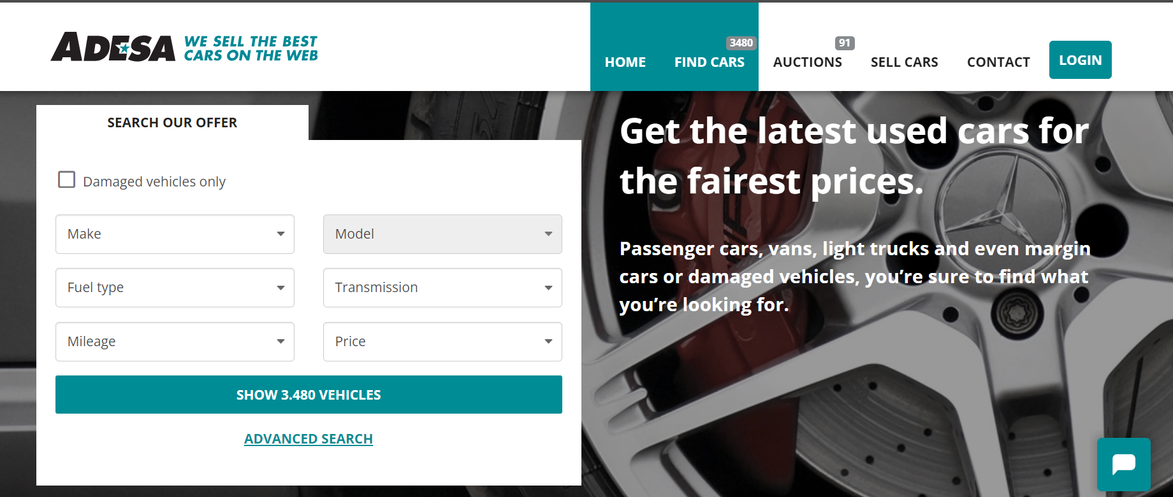
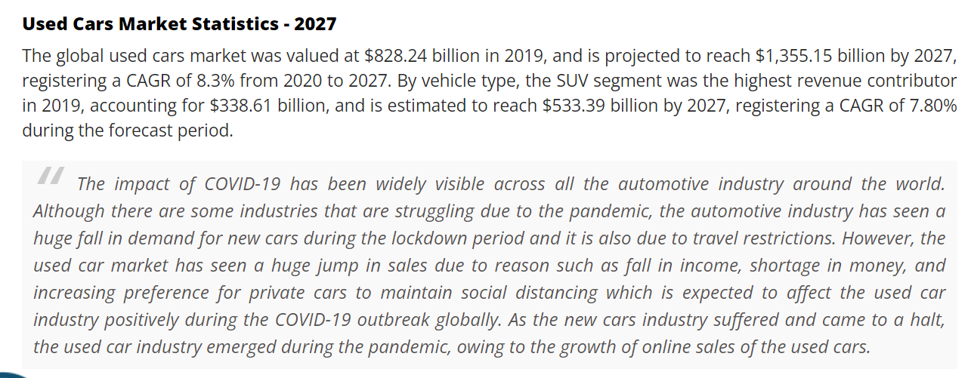
Context
Data
Exploratory data analysis
Feature Engineering
Model validation
Model training
Predict if a new customer will be coming back to purchase again? )

Slide 3
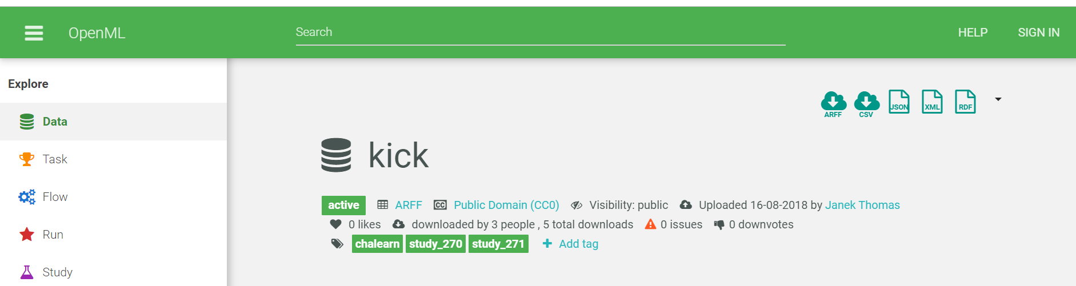
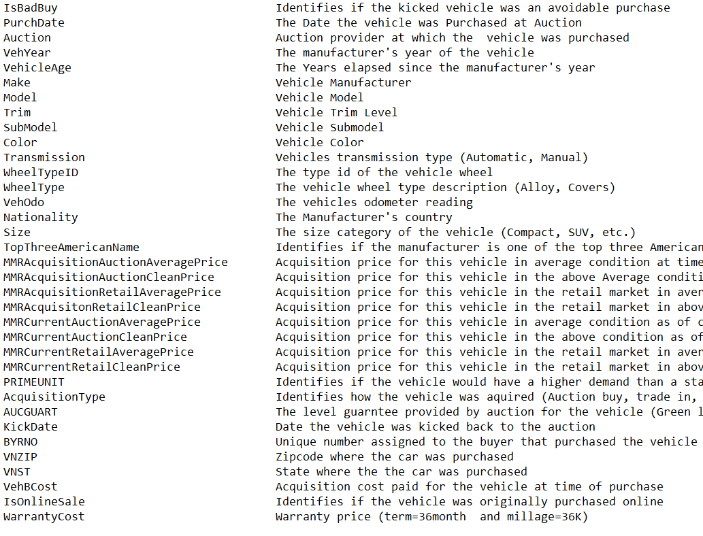
Context
Data
Exploratory data analysis
Feature Engineering
Model training
FEATURES

Slide 4
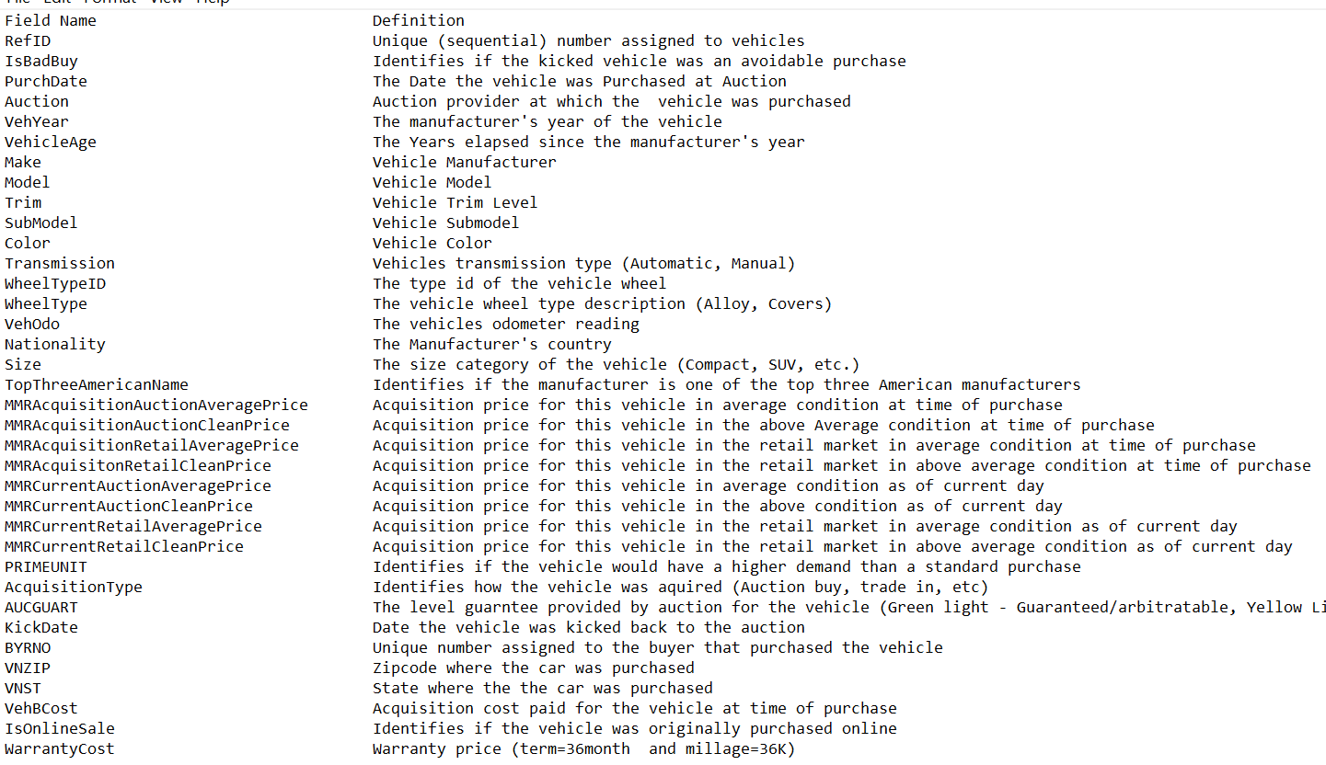
Context
Data
Exploratory data analysis
Feature Engineering
Model training
TARGES
FEATURES

Slide 5
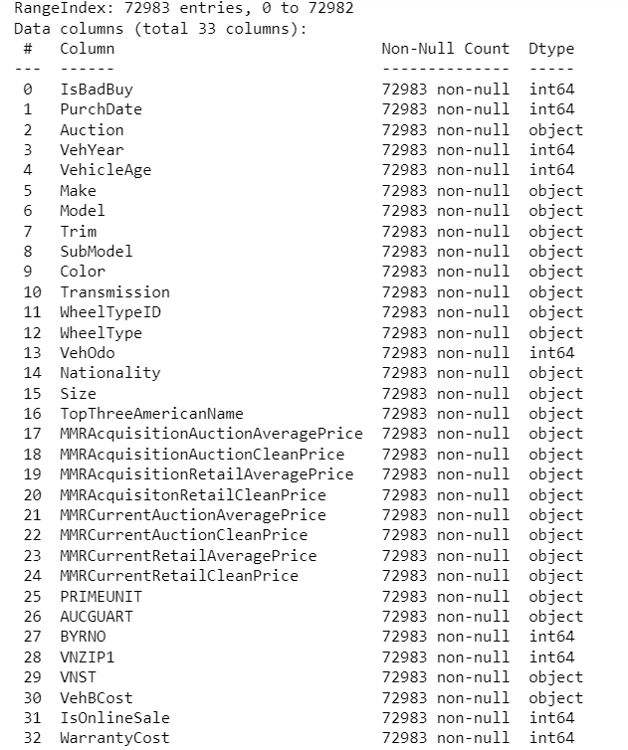
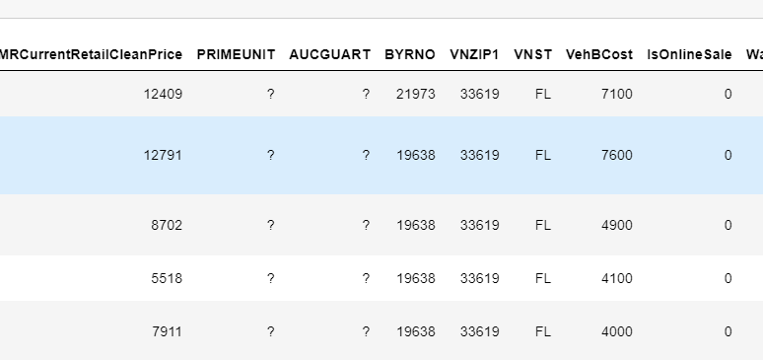
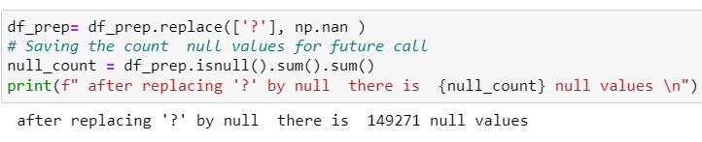
Context
Data
Exploratory data analysis
Feature Engineering
Model training

Slide 6
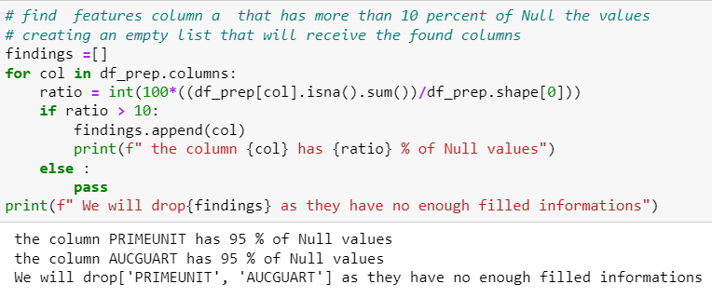
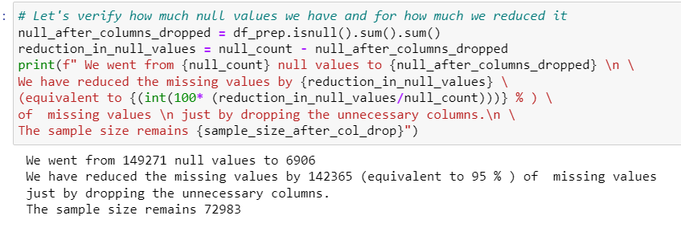
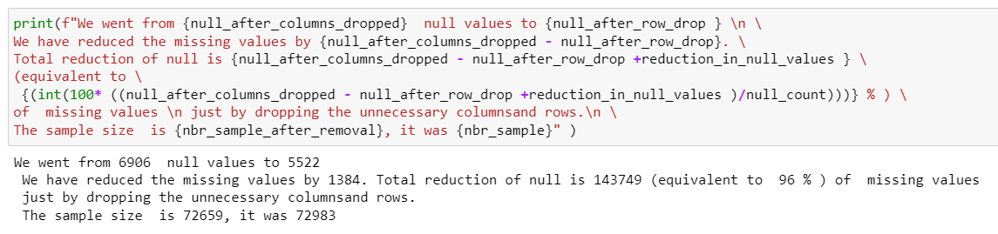
Context
Data
Exploratory data analysis
Feature Engineering
Model training

Slide 7
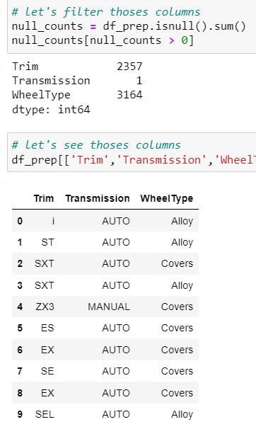
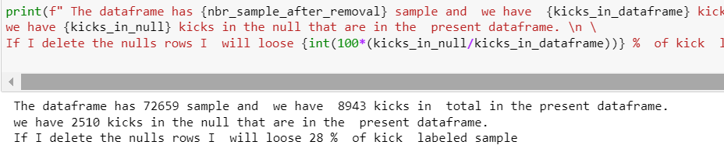
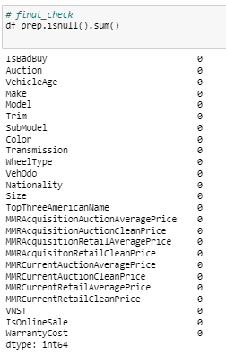
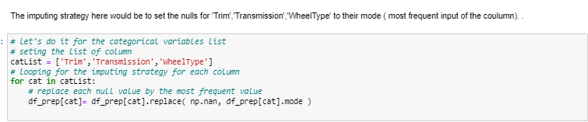
Context
Data
Exploratory data analysis
Feature Engineering
Model training

Slide 8
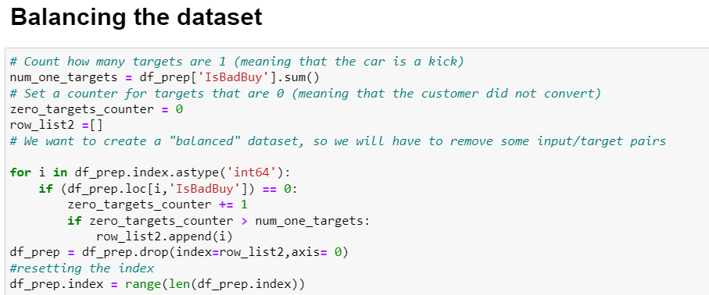
Context
Data
Exploratory data analysis
Feature Engineering
Model training

Slide 9
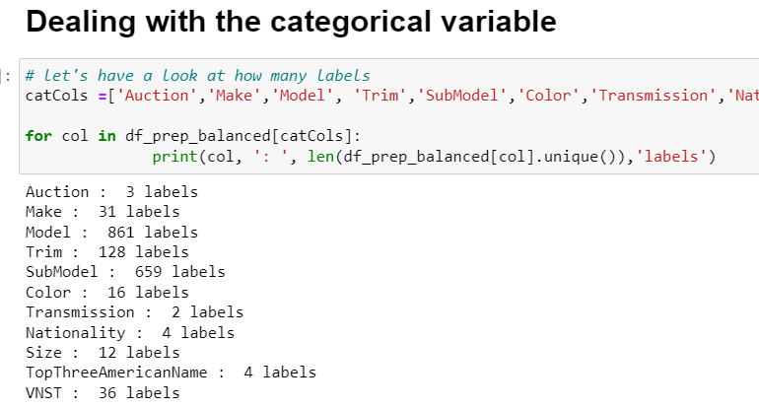
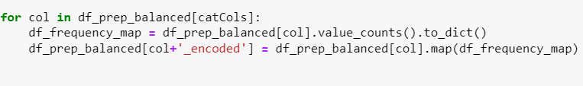
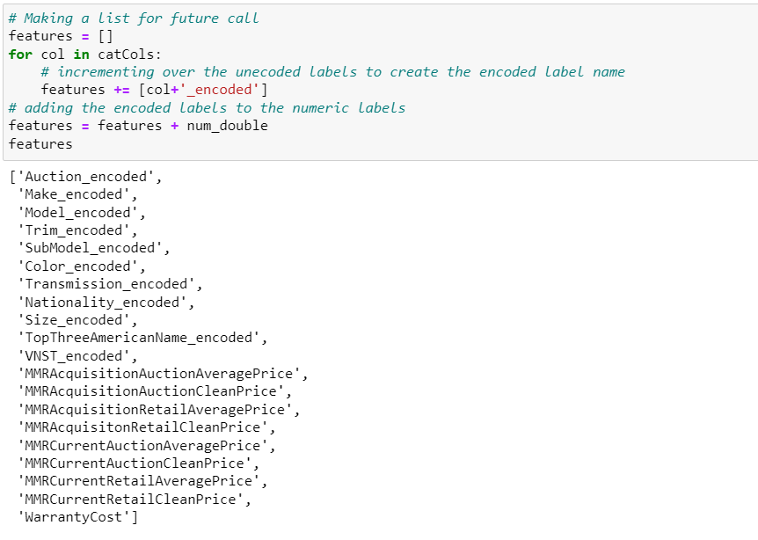
Context
Data
Exploratory data analysis
Feature Engineering
Model training

Slide 10
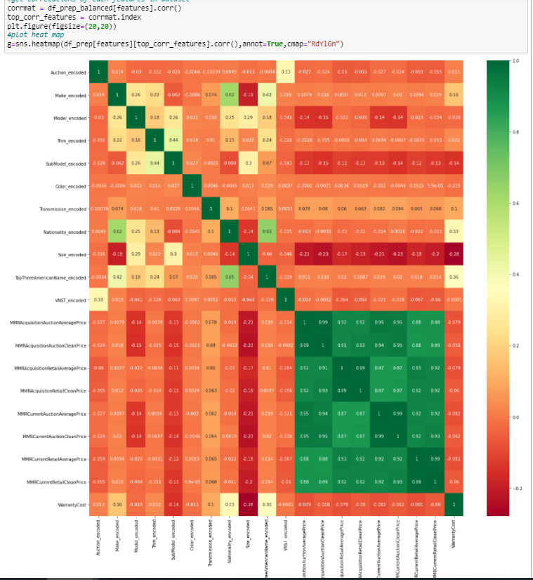
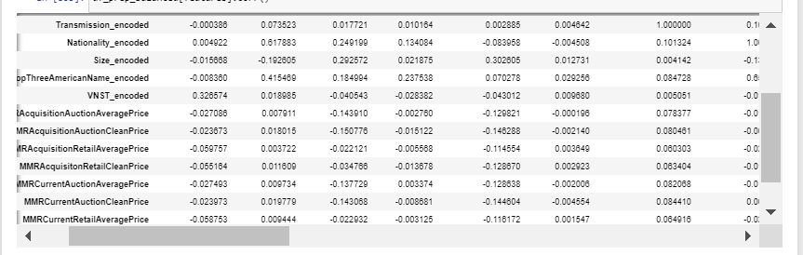
Context
Data
Exploratory data analysis
Feature Engineering
Model training

Slide 11
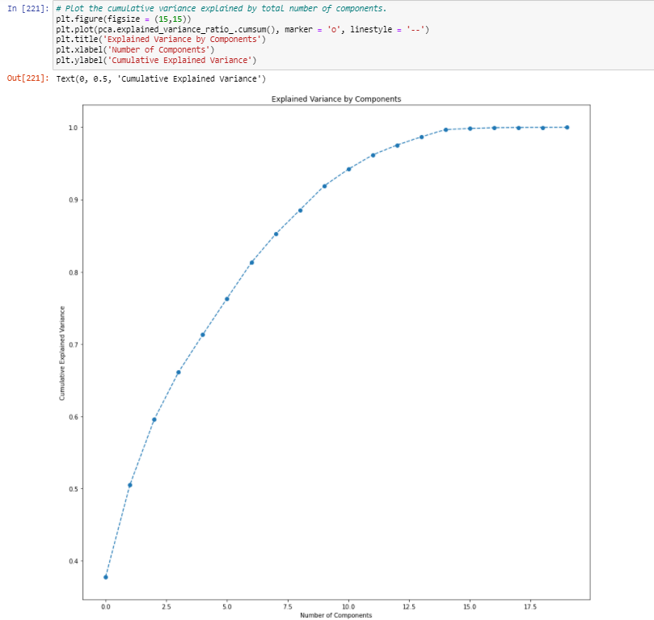
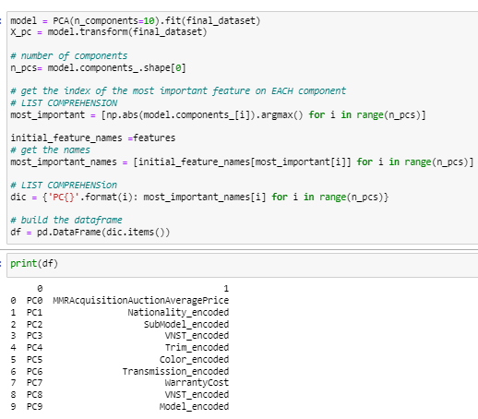
Context
Data
Exploratory data analysis
Feature Engineering
Model training

Slide 12
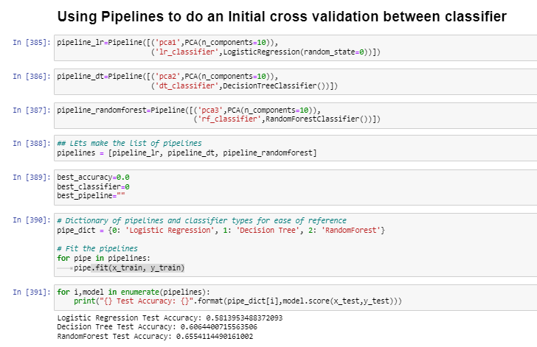
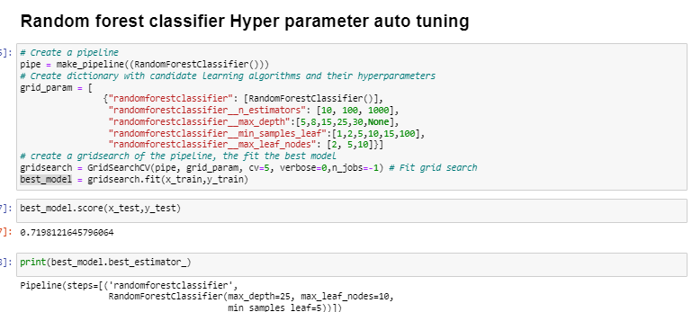
Context
Data
Exploratory data analysis
Feature Engineering
Model training

Slide 13
Deployement

